Slide 1
What is TEACH?
TEACH is an electronic account, established by you,
so that NYS has a profile regarding your eligibility to teach.
TEACH acts as a warehouse for all of the information about your certification.

Slide 2
Tips to Create a TEACH Account
Make sure you don’t already have a TEACH account.
Don’t forget your User Name and Password.
If you already have a TEACH account, DO NOT CREATE A NEW ACCOUNT. Use “Forgot Your Username or Password” at the bottom, or contact TEACH directly.
Canisius cannot help you retrieve your username or password – you will need to call or email OTI.
Creating a User Name and Password does not mean your account is all set up. You have to go through the login process.

Slide 3
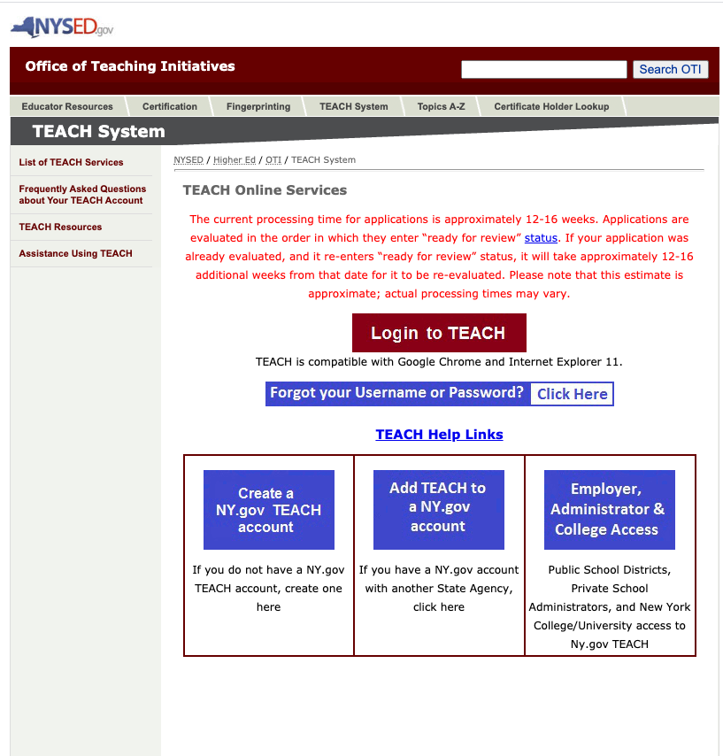
Create a TEACH Account
http://www.highered.nysed.gov/tcert/teach/
Click on this link

Slide 4
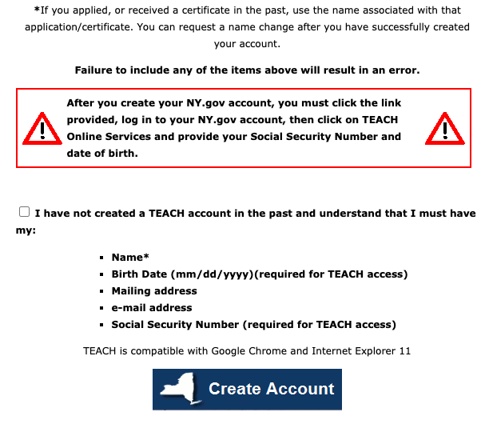
Create a TEACH Account
Check box
Click here to create account

Slide 5
Create a TEACH Account

Slide 6
Fingerprinting
Visit NYSED New Procedures for Fingerprinting for fingerprinting instructions.
All applicants for New York State Teacher Certification are required to have a fingerprint supported criminal history background check processed through the Office of School Personnel Review and Accountability (OSPRA)
After your fingerprints have been processed by OSPRA, your TEACH account will contain the following statement: "Your DCJS and FBI results have been received". You will not receive anything from OSPRA unless a school district requests a fingerprint clearance report for you.
It typically takes 24 hours for fingerprints to be processed through OSPRA.
Total Cost for fingerprinting - $102.00

Slide 7
NYSED New Procedures for Fingerprinting - Link
Click Link

Slide 8
https://uenroll.identogo.com/workflows/14ZGQT
You are exiting the New York State
Education Department's (NYSED) web site.
The site you are about to visit (Schedule fingerprinting for Certification applicants) is not under the jurisdiction of the NYSED, and the NYSED is not responsible for its
content.
Click the link above to continue or CANCEL
Click Link

Slide 9
Schedule Fingerprinting for Certification Applicants

